Slide 1
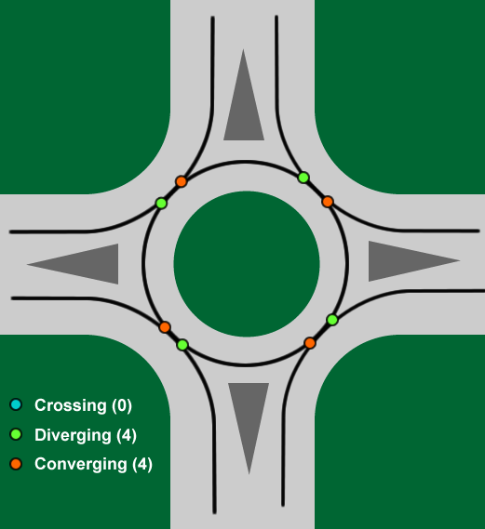
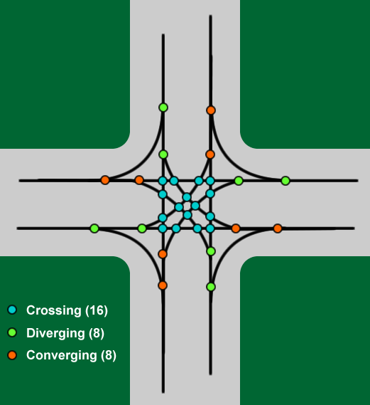
Roundabouts: Safer for Vehicles
Slower vehicle speeds (under 30 mph) means less severe crashes
90% reduction in fatalities, 76% reduction in injury crashes
75% fewer vehicle conflict points
Elimination of crossing conflicts prevents right-angle and left turn crashes

Slide 2
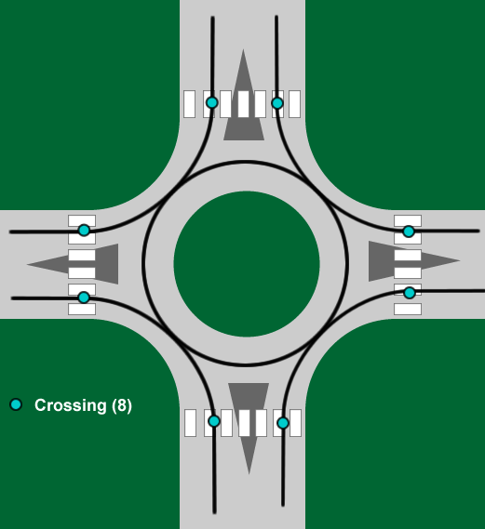
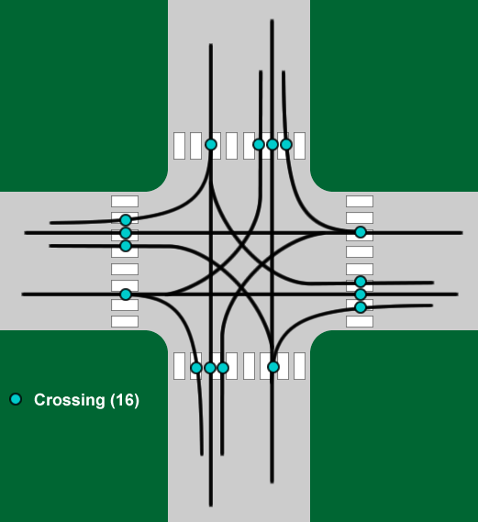
Roundabouts: Safer for Pedestrians
Slower vehicle speeds (under 30 mph) reduces fatalities in pedestrian crashes
30-40% reduction in pedestrian crashes
Pedestrians cross only one lane of traffic at a time
Gap identification is easier as conflicting vehicles arrive from only one direction

Slide 3
LEVEL OF SERVICE
Intersections are classified using a term known as ‘Level of Service’.
‘Level of Service’ defines the amount of delay the average vehicle will encounter during
Peak hour travel time through the intersection, and is defined below:
Level of Service | Average Vehicle Delay
 | Stop Controlled or Roundabout Intersection | Signalized Intersection
A | Less than 10 seconds | Less than 10 seconds
B | 10 seconds to 15 seconds | 10 seconds to 20 seconds
C | 15 seconds to 25 seconds | 20 seconds to 35 seconds
D | 25 seconds to 35 seconds | 35 seconds to 55 seconds
E | 35 seconds to 50 seconds | 55 seconds to 80 seconds
F | Greater than 50 seconds | Greater than 80 seconds
Womack Road at Vermack Road ‘Level of Service’
 |  | Current Year (2012)/Design Year (2037) Level of Service
 |  | No Improvements |  | Roundabout |  | Signal
 |  | AM Peak | PM Peak | AM Peak | PM Peak | AM Peak | PM Peak
Womack Road | Eastbound | F/F | F/F | A/A | A/A | A/A | B/B
 | Westbound | F/F | F/F | A/A | A/A
Vermack Road | Northbound | F/F | D/F | A/A | A/B
 | Southbound | F/F | D/E | A/A | A/A

