Slide 1
DUNWOODY
COMPREHENSIVE
PLAN UPDATE 2020
Data prepared by ARC (January 2020)

Slide 2
DEMOGRAPHIC TRENDS

Slide 3
POPULATION CHANGE
+6.4%
+19.4%
Data Sources: US Census; Esri Business Analyst

Slide 4
POPULATION COMPARISON
Data Source: US Census; American Community Survey

Slide 5
AGE DISTRIBUTION
Dunwoody: 2019
This population pyramid illustrates the distribution of age groups in Dunwoody.
The square-like structure of Dunwoody’s population, with a bulge toward the middle ages, reflects the city’s large economically active age group.
Data Source: Esri Business Analyst
85+
80 - 84
75 - 79
70 - 74
65 - 69
60 - 64
55 - 59
50 - 54
45 - 49
40 - 44
35 - 39
30 - 34
25 - 29
20 - 24
15 - 19
10-14
5-9
0-4
Population

Slide 6
AGE DISTRIBUTION COMPARISON
Dunwoody
10-COUNTY METRO ATLANTA AREA
85+
80 - 84
75 - 79
70 - 74
65 - 69
60 - 64
55 - 59
50 - 54
45 - 49
40 - 44
35 - 39
30 - 34
25 - 29
20 - 24
15 - 19
10-14
5-9
0-4
85+
80 - 84
75 - 79
70 - 74
65 - 69
60 - 64
55 - 59
50 - 54
45 - 49
40 - 44
35 - 39
30 - 34
25 - 29
20 - 24
15 - 19
10-14
5-9
0-4
Percent of Population
Percent of Population
These charts depict a comparison between the age group proportions in the City of Dunwoody to those for the entire Atlanta Metro. The age-sex distribution in Dunwoody closely mirrors the distribution of the metro, though Dunwoody’s population has a proportionally large over-70 population.
Data Source: Esri Business Analyst

Slide 7
RACIAL COMPOSITION
2010
2019
Between 2010 and 2019, the City of Dunwoody became more diverse.
The proportion of all residents of color, and residents who identified as two or more races increased, while the proportion of white residents decreased.
9.6% of residents of any race identified as Latino in 2010, and this percentage increased slightly, to 9.7% by 2019.
Data Sources: US Census;
Esri Business Analyst

Slide 8
RACIAL COMPOSITION
Dunwoody
2019
10-COUNTY ATLANTA METRO
2019
The racial distribution in Dunwoody reflects the racial distribution in the 10-county metro loosely, though Dunwoody is home to a smaller proportion of residents of color than the Metro Area.
Dunwoody’s population is proportionately more white and Asian than that of the Metro Area.
Data Source: Esri Business Analyst
Dunwoody’s Hispanic population is also smaller than that of the Metro Area, with Hispanic residents comprising only 9.7% of the population, while 12% of the Metro’s population is Hispanic.

Slide 9
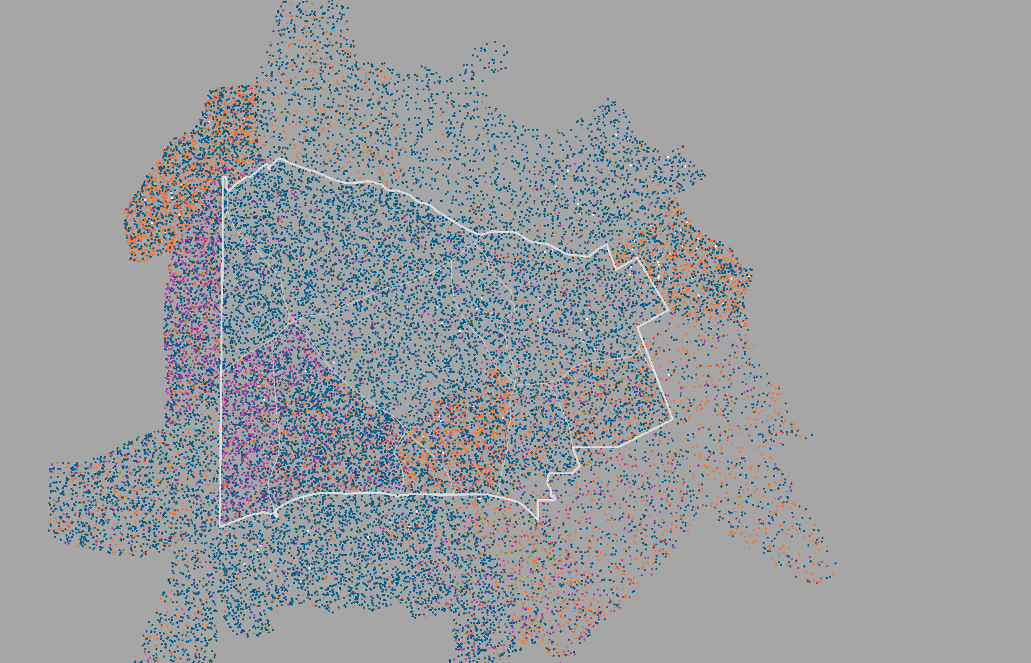
RACIAL DISTRIBUTION
LEGEND
1 DOT = 3.5 PEOPLE
Dunwoody City Limits
Major Roads
White
Black
Asian
American Indian
Pacific Islander
2 or More Races
Some Other Race
Data Source: American Community Survey

Slide 10
HOUSING TRENDS

Slide 11
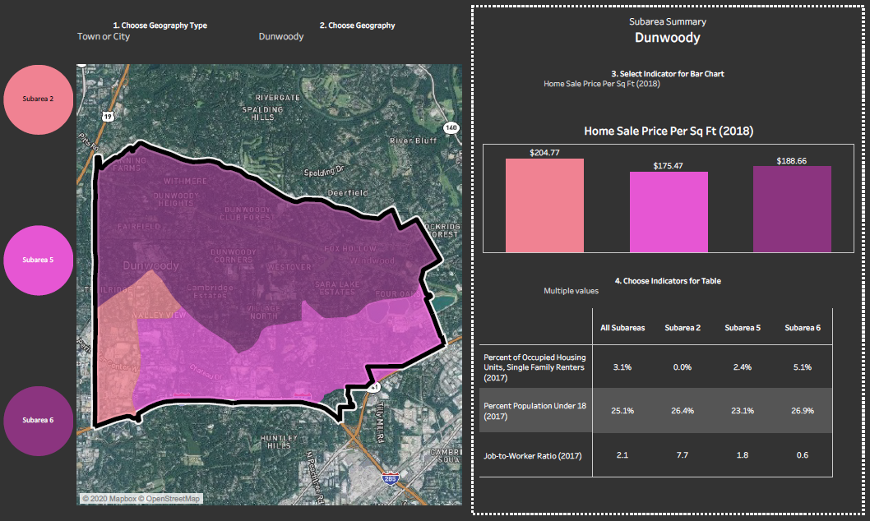
METRO ATL HOUSING STRATEGY
SUBAREA 2
Neighborhoods near the city core and employment corridors, with a mix of newer and older higher priced homes and higher rents.
SUBAREA 5
Moderate-to-higher-priced suburban neighborhoods near employment centers with a mix of single family and multifamily units housing both renters and owners.
SUBAREA 6
Moderate-to-higher-priced suburban neighborhoods consisting almost entirely of single family homes.
Data Source: metroATLhousing.org

Slide 12
HOUSING TENURE
10-County Atlanta Metro Occupancy Projections
7.1%
6.8%
8.0%
8.6%
Data Source: Esri Business Analyst

Slide 13
HOUSING TYPES
Dunwoody is experiencing a moderate shift in the composition of its housing stock. While the city has gained roughly 1,200 dwelling units, that growth has been concentrated in multifamily homes. Simultaneously, the proportion and count of single family homes have decreased.
Data Source: American Community Survey, 2018

Slide 14
HOUSEHOLD INCOME DISTRIBUTION: RENT V. OWN
Owners Income Distribution
Renters Income Distribution
63% of homeowning households in Dunwoody have an income in excess of $100,000 annually, whereas 31% of renters fall into that income category. The median income of renter households in Dunwoody is $72,371, while the median homeowner annual income is $131,287.
Data Source: American Community Survey, 2018

Slide 15
MONTHLY HOUSING COSTS: RENT V. OWN
The vast majority of renters spend between $1,000 and $1,999 on housing costs each month, while housing costs for homeowners are more evenly distributed. The largest percentage of homeowners spend above $2,000 on housing costs monthly.
Data Source: American Community Survey, 2018

Slide 16
HOUSING EXPENDITURES
Area Median Home Value Estimates
American Communities Survey Estimate 2018:
Zillow Estimate, 2019 Average:
ESRI Business Analyst Online Estimate 2019:
Selected Median Owner Costs, 2018:
Average Monthly Rent 2018
$418,800
$451,608
$437,516
$1,711/mo
$1,453/mo

Slide 17
SEVERELY COST BURDENED HOUSEHOLDS
Dunwoody’s lowest income households struggle to pay for housing and other basic necessities. About a quarter of the city’s households are cost burdened, paying over 30% of their income toward housing. In addition, roughly 12% of Dunwoody’s households are severely housing cost burdened, paying more than 50% of their income toward housing.
Data Source: U.S. Department of Housing & Urban Development, CHAS 2012-2016 5-Year American Community Survey, Dunwoody City. Note: These are rough estimates.
AMI – Area Median Income – is calculated by the U.S. Department of Housing & Urban Development. In 2016, the AMI for the Atlanta Metro Area was $67,500.

Slide 18
ECONOMIC TRENDS

Slide 19
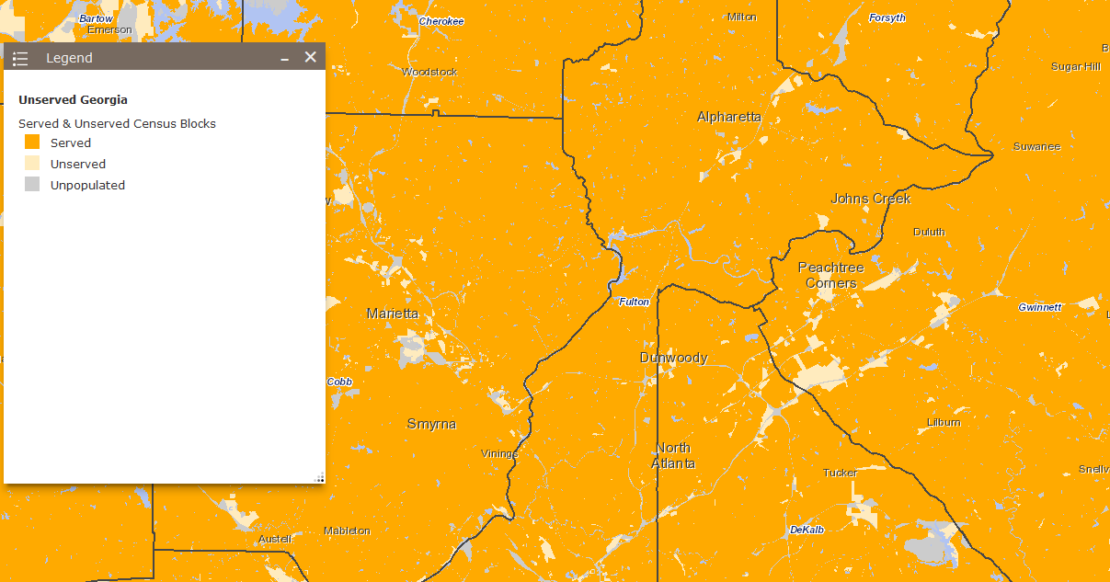
BROADBAND AVAILABILITY
$40,645
$45,233
$42,688
According to the most recent available data, only 1% of households and businesses in DeKalb county were unserved by broadband in 2017. The FCC reports that in 2017, 8% of locations statewide were unserved by broadband.
Source: Federal Communications Commission (FCC), 2017; Georgia Broadband Center, 2017

Slide 20
DUNWOODY MEDIAN HOUSEHOLD INCOME
$76,809
$94,561
$103,174
Data Sources: US Census Bureau; Esri Business Analyst Online

Slide 21
INCOME DISTRIBUTION
$40,645
$45,233
$42,688
The median household income in Dunwoody in 2019 is $94,561.
Most Dunwoody households make at least $75,000 a year. 22% make below $50,000 annually.
Data Source: Esri Business Analyst Online

Slide 22
INCOME DISTRIBUTION COMPARISON
Dunwoody
10-County Atlanta Metro
$40,645
$45,233
$42,688
The City of Dunwoody has a large proportion of households earning well above the Metro Area’s median household income.
Data Source: Esri Business Analyst Online

Slide 23
WORKPLACE AREA CHARACTERISTICS
What jobs exist within Dunwoody?
In terms of employment, the largest industry within Dunwoody is Finance and Insurance by far, followed by Professional, Scientific, and Technical Services.
Note: This only represents the top ten Workplace Area Characteristics.
Data Source: US Census on the Map, Workplace Area Characteristics.
$40,645
$45,233
$42,688

Slide 24
RESIDENT AREA CHARACTERISTICS
What industries do Dunwoody residents work in?
In terms of employment, the largest industry among Dunwoody’s residents is Professional, Scientific, and Technical Services, followed by Health Care and Social Assistance.
Note: This depicts only the top 10 industries occupied by residents of Dunwoody. Others may be represented in the data that aren’t shown here.
Data Source: US Census on the Map, Resident Area Characteristics.
$40,645
$45,233
$42,688

Slide 25
TRANSPORTATION TRENDS

Slide 26
WORK COMMUTES
Commute In to Dunwoody:
Commute Out of Dunwoody:
42,194
19,568
Live and Work In Dunwoody:
2,165
Data Source: US Census on the Map, Inflow/Outflow Analysis

Slide 27
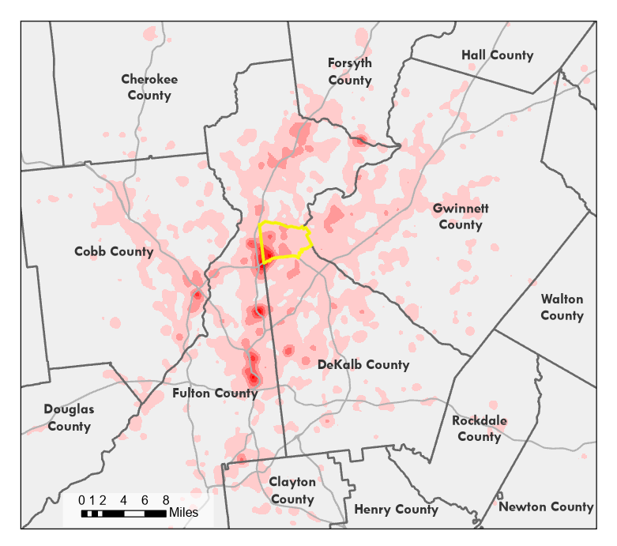
WHERE DUNWOODY RESIDENTS WORK
LEGEND
Dunwoody City Limits
County Boundaries
Expressways
5-75 Jobs per Square Mile
76-285 Jobs per Square Mile
286-636 Jobs per Square Mile
637-1128 Jobs per Square Mile
1129-1760 Jobs per Square Mile
Data Source: Census on the Map, 2017

Slide 28
COMMUTE TIME
16.9% of residents travel <15 minutes
38% of residents travel <10 miles
42.4% of residents travel 15-29 minutes
27.8% of residents travel 30-44 minutes
8.1% of residents travel 45-59 minutes
4.9% of residents travel >60 minutes
Data Source: American Community Survey, 2018

Slide 29
MODE OF TRANSPORTATION
84% of Dunwoody residents use a car to get to work each day. The vast majority of those drive alone, while 8% carpool. 6% of residents use public transportation, 8% work from home, and another 2% use alternative modes of transportation such as walking or biking to get to work.
Data Source: American Community Survey, 2018

Slide 30
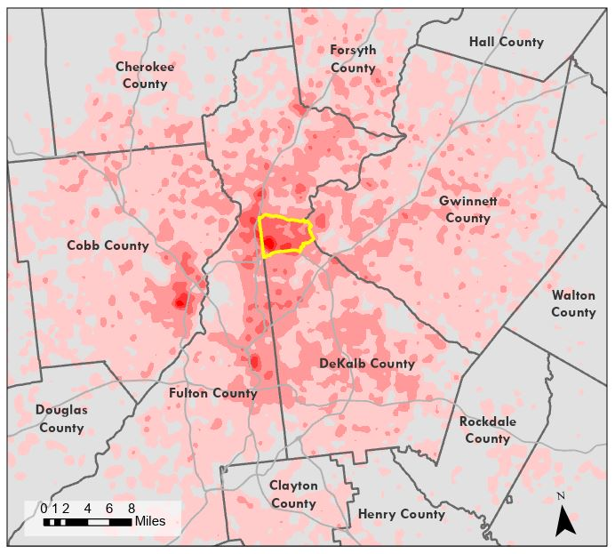
WHERE DUNWOODY WORKERS LIVE
This map provides a visualization of where the people who work in Dunwoody call home.
During workdays, Dunwoody accommodates roughly 42,000 workers from outside the city, while only 19,000 Dunwoody residents leave the city for work, creating a daily influx of around 23,000 people.
LEGEND
Dunwoody City Limits
County Boundaries
Expressways
5-27 Jobs per Square Mile
28-95 Jobs per Square Mile
96-205 Jobs per Square Mile
209-366 Jobs per Square Mile
367-570 Jobs per Square Mile
Data Source: Census on the Map, 2017

Slide 31
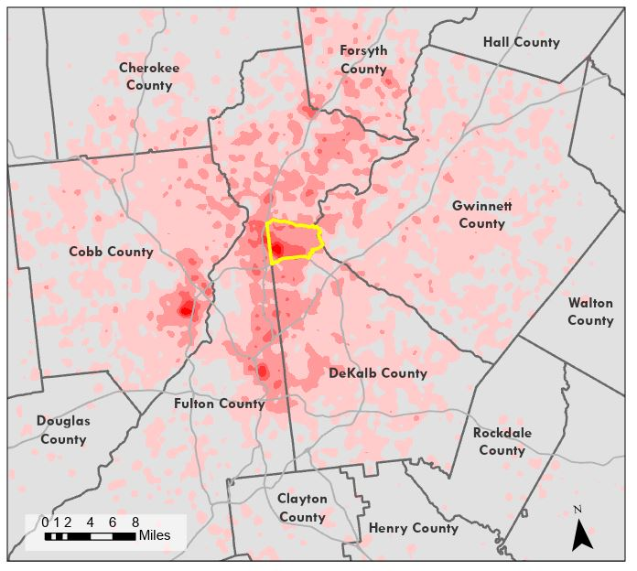
WHERE DUNWOODY WORKERS LIVE
This map provides a visualization of where the people who work in Dunwoody call home.
This map is filtered to show only where people earning greater than $3,333 per month (roughly $40,000 annually) live.
LEGEND
Dunwoody City Limits
County Boundaries
Expressways
5-23 Jobs per Square Mile
24-77 Jobs per Square Mile
78-167 Jobs per Square Mile
168-293 Jobs per Square Mile
294-456 Jobs per Square Mile
Data Source: Census on the Map, 2017

Slide 32
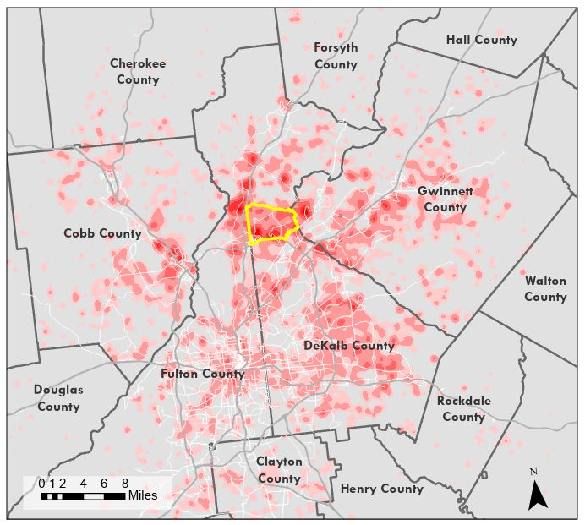
WHERE DUNWOODY WORKERS LIVE
This map provides a visualization of where the people who work in Dunwoody call home.
This map is filtered to show only where people earning between $1,251 and $3,333 monthly (between $15,000 and $40,000 annually) live.
LEGEND
Dunwoody City Limits
County Boundaries
Expressways
5-9 Jobs per Square Mile
10-24 Jobs per Square Mile
25-48 Jobs per Square Mile
48-81 Jobs per Square Mile
82-125 Jobs per Square Mile
Data Source: Census on the Map, 2017

Slide 33
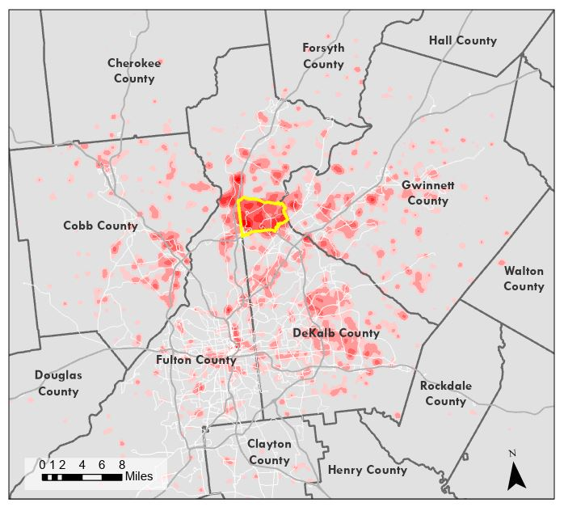
WHERE DUNWOODY WORKERS LIVE
This map provides a visualization of where the people who work in Dunwoody call home.
This map is filtered to show only where people earning less than $1,250 monthly ($15,000 annually) live.
LEGEND
Dunwoody City Limits
County Boundaries
Expressways
5-7 Jobs per Square Mile
8-15 Jobs per Square Mile
16-27 Jobs per Square Mile
28-45 Jobs per Square Mile
46-68 Jobs per Square Mile
Data Source: Census on the Map, 2017

